Slide 1

Recommendation System Bind Rate Calculations

Slide 2


Introduction
Zachary Miller
Specializations
Software engineering
Artificial intelligence & robotics
After college
Looking to become a data scientist/machine learning engineer
Ideally staying within Wisconsin

Slide 3

Disclaimer before I begin
Disclaimer
I signed a non-disclosure agreement (NDA)
This presentation has been reviewed by my boss
My explanation/demo is a compromise between my former employer and the university

Slide 4

Timeline
Started work with the insurance company in May 2022
Joined a data science team in August 2022
Original deadline was December 2nd
Extended to January 20th
My senior seminar presentation covers my time with the data science team

Slide 5
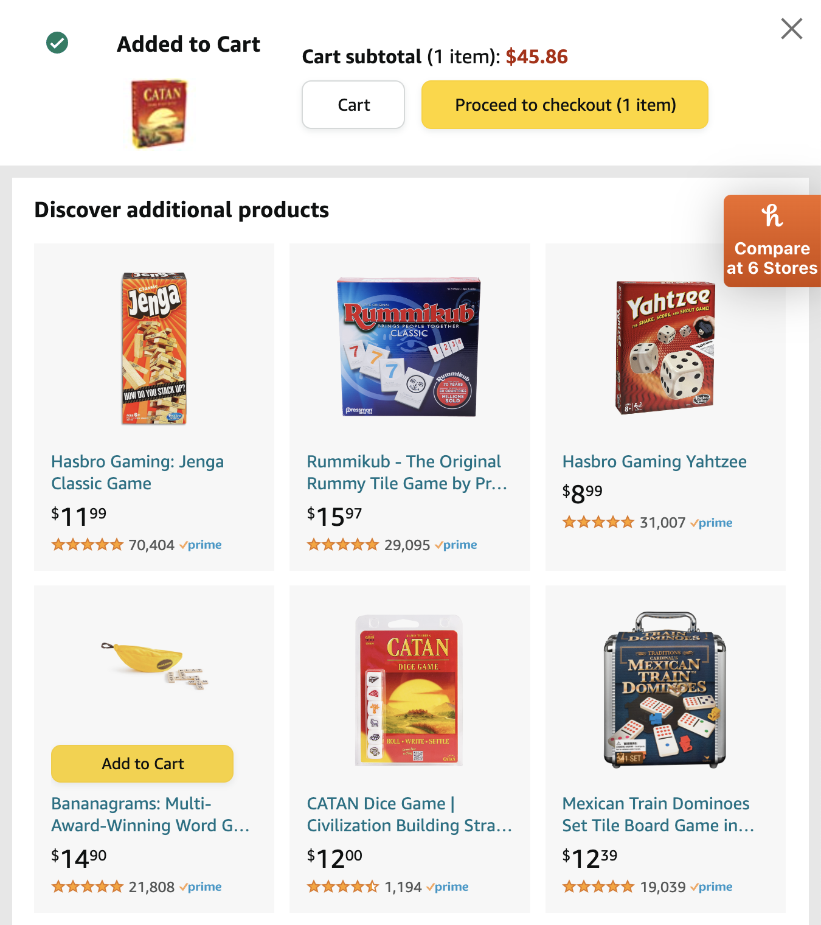

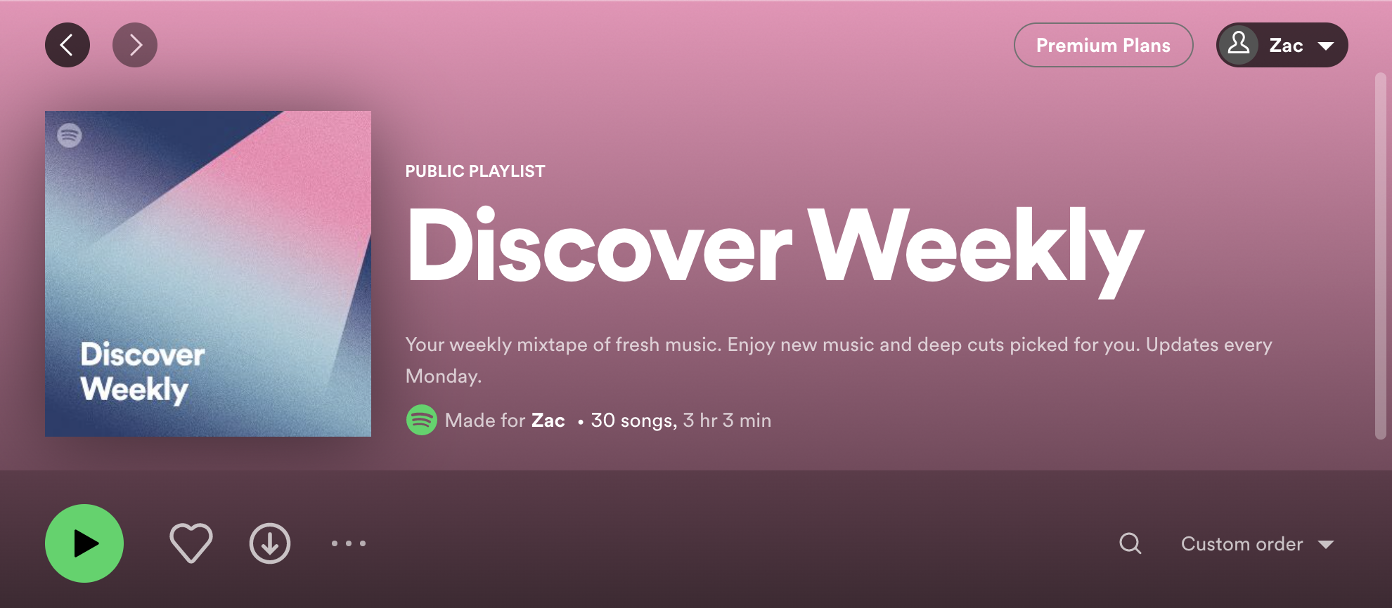
What is a recommendation system?
Recommendation systems are a staple of businesses that sell a plethora of products online.
Amazon
Discover additional products
Netflix
Top Picks
Spotify
Discover Weekly

Slide 6



Who are the users?
Two groups use the recommendation system
1) Used by customers whenever they log in to:
a) Website application
b) Mobile application
2) Used by call center representatives when a call connects with an existing customer

Slide 7

Generalization of how the system works
Two channels
Non-digital (representatives)
Digital (website and mobile app)
Slightly different process depending on which channel is used

Slide 8

Non-digital channel (reps)
Non-digital
1) Existing customer calls a representative, the recommender system is run
2) If/then statements filter down possible recommendations and an additional AI model is applied
3) Policy recommendations are sent to the representative’s screen
3a) If a recommendation makes it here, is_recommended = True
4) The representative can ask the customer if they’d be interested in one of the recommended policies
4a) If the representative offers the policy, offered = True
5) The customer can show or not show interest in the offer
5a) If the customer is interested, interested = True
6) The representative can ask the customer if they’d like to buy the recommended policy
6a) If the customer buys the policy, bound = True
is_recommended → offered → interested → bound

Slide 9


Digital channel (web app)
Digital
1) Existing customer logs on
2) If/then statements filter down possible recommendations from a list
2a) If a recommendation makes it this far, then is_recommended = True
3) Some of the policy recommendations are sent to populate a banner in the UI
3a) If a policy makes it here, then offered = True
4) The user sees the recommendation in the banner and can click it
4a) If the offer is clicked, then interested = True
bound != True in the Digital platform, as a user can’t sign themselves up for a policy without a human interaction
is_recommended → offered → interested

Slide 10

Regardless of which channel and path is taken…
The results will be stored in a database
One row per each recommendation
Each row keeps track of:
1) interaction_id
2) is_recommended
3) offered
4) interested
5) bound
6) line
7) channel

Slide 11

What’s the problem?
No metrics exist to measure the performance of the recommender system!
No idea how well certain recommendations were received over time
No idea how many recommendations had interest shown in them
No idea how many recommendations resulted in a sale (bind)

Slide 12

Why does it need to be solved?
The insurance company created the recommender, so…
It would be useful to know how well it is performing
It would be useful to be able to compare the recommender’s performance between quarters
It would be useful to know if there are any areas where the recommender is lackluster

Slide 13

What is my proposed solution?
Calculate a variety of metrics for the recommender’s success
Two primary metrics
Bind rate
IE: What proportion of recommended policies were bound?
Numerator = All bound policies
Denominator = All recommended policies from the non-digital channel
Interested rate
IE: What proportion of recommended policies did a customer show interest in?
Numerator = interested policies from one or both channels
Denominator = recommended policies from one or both channels
These are simply fractions

Slide 14

What else should be considered?
Line of insurance?
Auto, life, home, etc…
Granularity of the denominator
Per offer
Denominator = number of recommendations that were offered
Per recommendation
Denominator = number of recommendations made
Per session
Denominator = number of sessions with a recommendation
Understandability
Carefully thought-out comments and documentation are necessary for the next data scientist to use my work

Slide 15




What tools were used to solve the problem?
AWS
EC2
Virtual machine service
S3
Database service
Athena
Database querying service
Python
One python script per calculation (numerator/denominator)
Dozens of scripts were written for the project
For the demonstration, I have mimicked only a few

Slide 16


Demo of solution
1) Mock data in excel
2) Mock python scripts

Slide 17

What was easier and harder than expected
Harder
Understanding the problem was exceedingly difficult
Motivated me to write unambiguous documentation with step-by-step instructions to reach the point that I had
No prior experience with AWS
Easier
Python scripting
SQL querying

Slide 18


If I had another month, what else would I do?
Additional granularities of denominator
Testing the recommender system with control groups
Determining how much of the recommender’s success could be attributed to the AI system, and how much could be attributed to random chance and deviation

Slide 19

Thank you!

